Slide 1


HematoVision: Advanced Blood Cell Classification UsingTransfer Learning
  Submitted by:
  KAGITALA SAIKUMAR 228X1A4235
  DODDAKA VENKATA CHANDU 228X1A4221
  RAVI LAKSHMI SAI VARUN 218X1A4279
  KAMBALA VENKATA SAI PREM CHAND 228X1A4260
Under the Esteemed Guidance of
Mr.K.VINOD
CSE - (AI & ML)

Slide 2
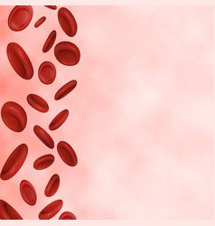
Table of Contents
Introduction
Abstract
Literature Survey
Architecture
Web Application
Technologies Used
Transfer Learning Concept
Applications
Advantages
Conclusion
References

Slide 3

Hematovision is an AI-based project focused on advanced blood cell classification using transfer learning to detect, classify, and analyze white blood cell (WBC) subtypes. Developed as part of an AI/ML internship initiative in collaboration with Smart Bridge/APSCHE, this project automates the identification of blood cells to support rapid, accurate medical diagnostics. An intelligent deep learning system for automated blood cell classification using transfer learning and CNNs.

Slide 4
Abstract:
This project focuses on identifying different types of blood cells using image processing and deep learning.
Users can upload microscopic blood cell images through a simple web interface.
The system uses a trained MobileNetV2 model to analyze and classify the images.
It predicts blood cell types such as Eosinophil, Lymphocyte, Monocyte, and Neutrophil.
The application provides fast and accurate results to assist in medical analysis.

Slide 5
Literature Survey
Previous studies show that blood cell classification can be done using image processing and deep learning methods.
Researchers have used CNN models to automatically detect and classify white blood cells from microscopic images.
Lightweight models like MobileNet provide good accuracy with faster performance and less computation.
These approaches help improve efficiency and accuracy in medical diagnosis compared to manual methods.

Slide 6
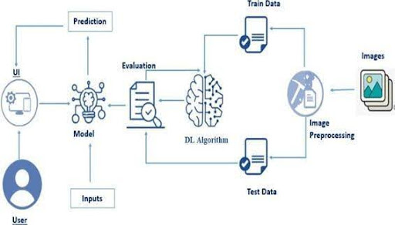
Architecture:
1.Blood cell images are first collected and passed through image preprocessing .
2.The processed images are split into training and testing datasets.
3.A transfer learning–based deep learning model pretrained CNN extracts features and learns to classify blood cell types.
4.The model is evaluated using test data to measure performance and accuracy.
5.The trained model is integrated with a user interface to provide final prediction results.

Slide 7
Web Application:
For Frontend we used:
Building HTML Pages:
For this project create Two HTML files namely
home.html
result.html
For Backend we used:
Build Python code:
App.py
Flask
MobileNetV2 deep learning model

Slide 8
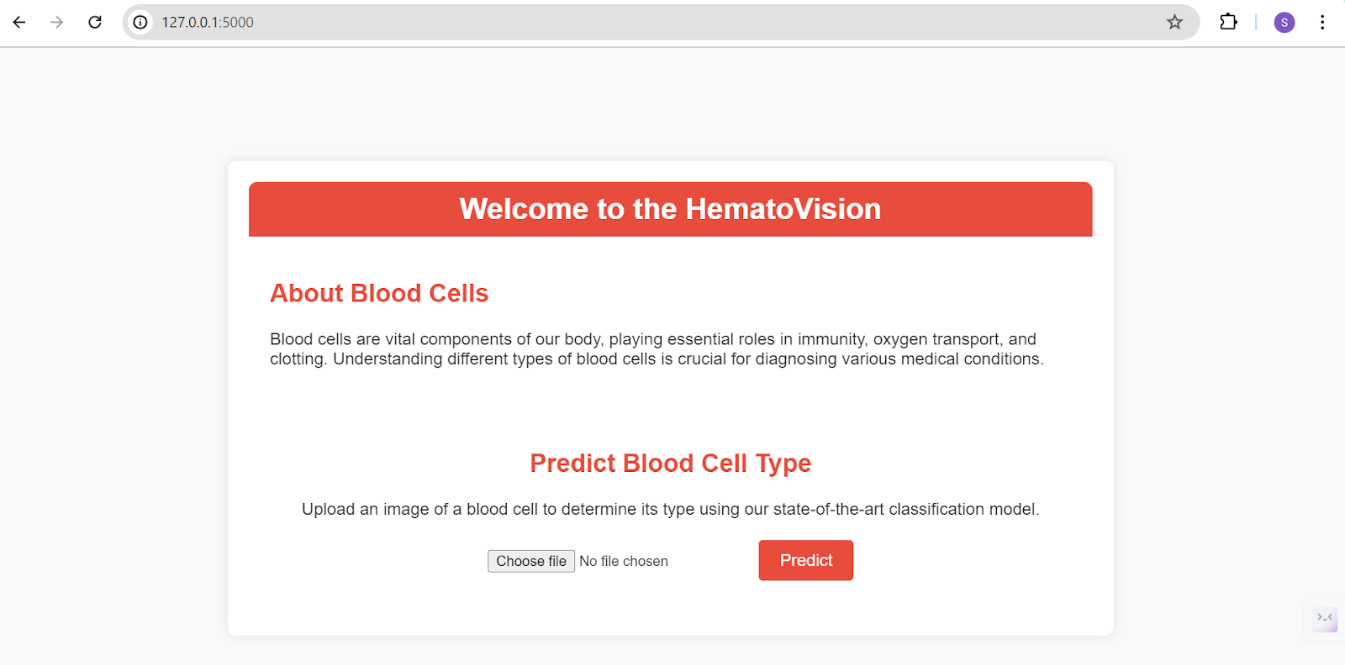
Let’s see what our index.html page looks like:

Slide 9
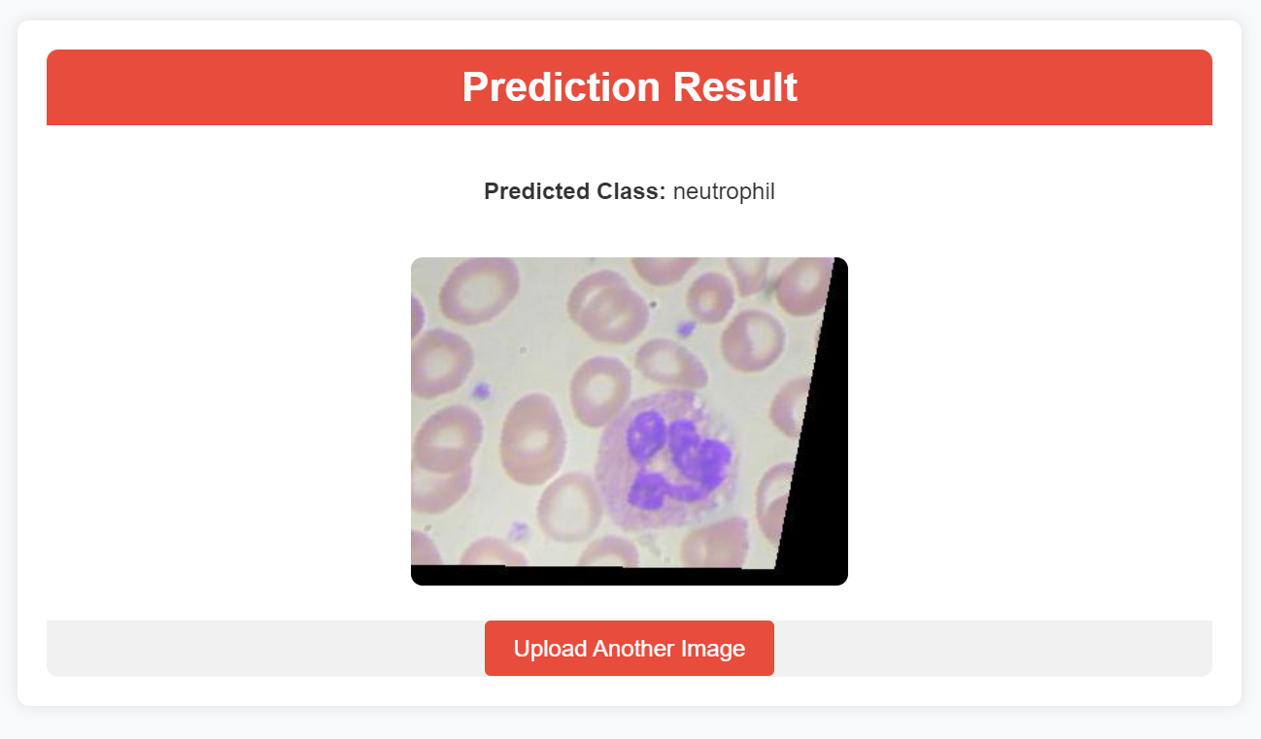
Test For Class-1 : Neutrophil
By clicking on choose file it will ask us to upload the image , then by clicking on the predict button , it will take us to the result.html
Neutrophils are white blood cells that form the first line of defense against infections by destroying bacteria and foreign particles.

Slide 10
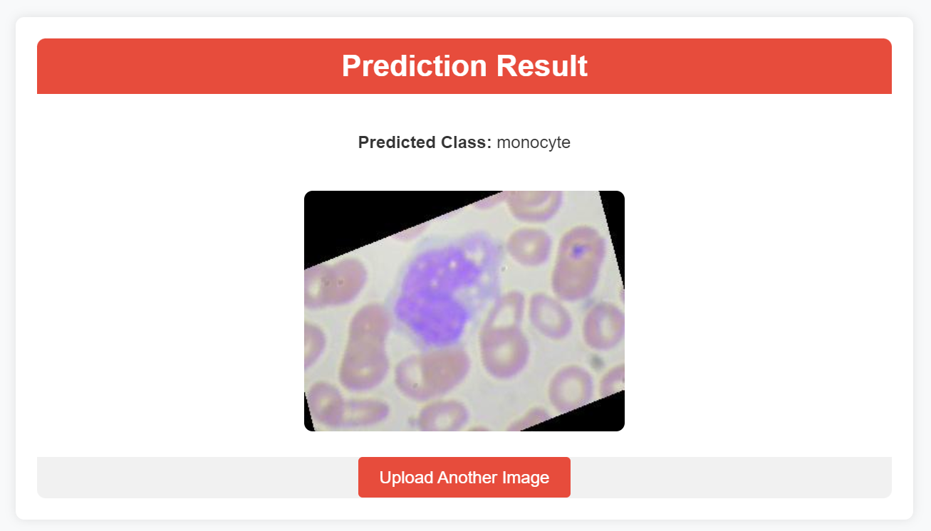
Test For Class-2 : Monocyte
By clicking on choose file it will ask us to upload the image , then by clicking on the predict button , it will take us to the result.html
Monocytes are white blood cells that help fight infections by ingesting pathogens and developing into macrophages or dendritic cells in tissues.

Slide 11
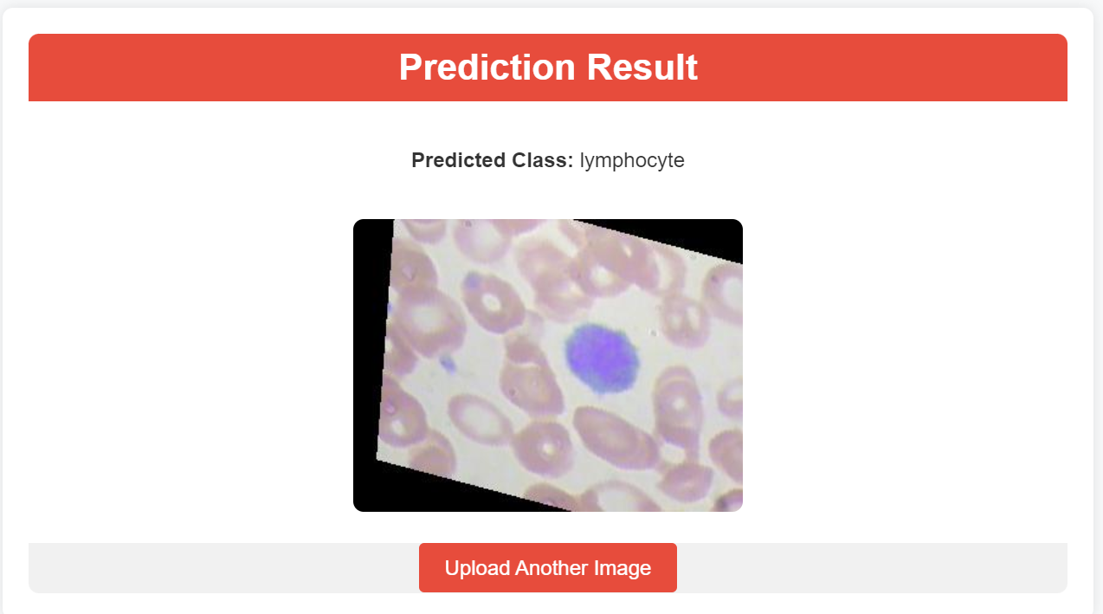
Test For Class-3 : Lymphocyte
By clicking on choose file it will ask us to upload the image , then by clicking on the predict button , it will take us to the result.html
Lymphocytes are white blood cells responsible for adaptive immunity, producing antibodies and coordinating immune responses against infections.

Slide 12
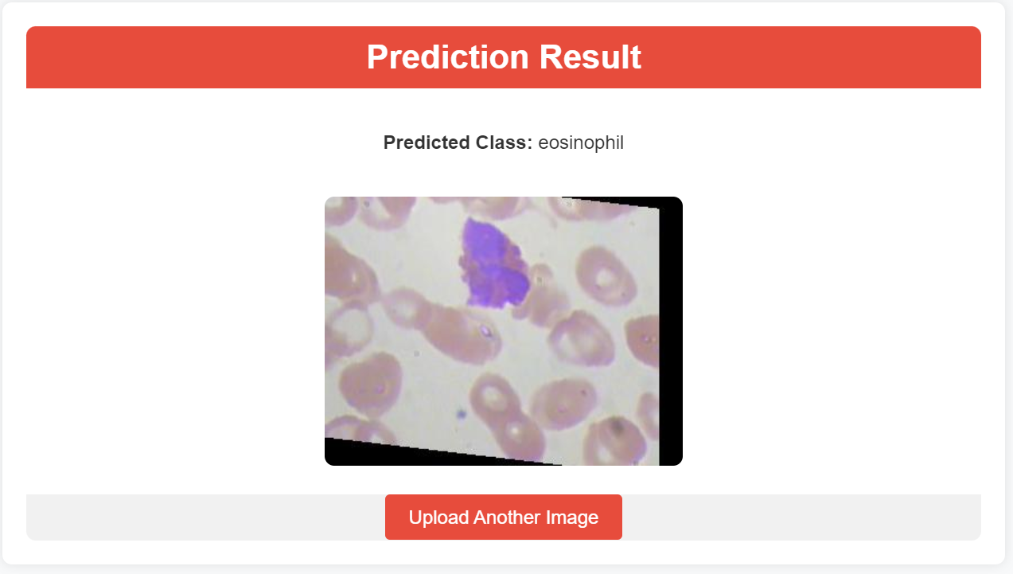
Test For Class-4 : Eosinophils
By clicking on choose file it will ask us to upload the image , then by clicking on the predict button , it will take us to the result.html
Eosinophils are white blood cells involved in combating parasitic infections and playing a role in allergic and inflammatory responses.

Slide 13
Technologies Used:
HTML for frontend design
Python for backend design
TensorFlow and Keras for deep learning
MobileNetV2 for transfer learning
Flask for web application development
Anaconda Navigator for environment management

Slide 14
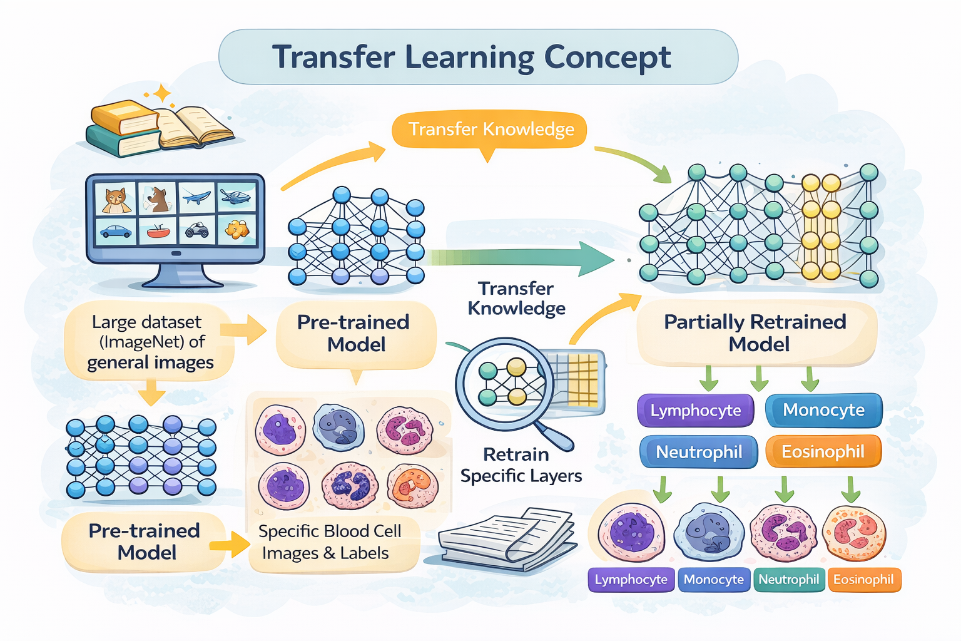
Transfer Learning Concept:
Transfer learning enables the use of pre-trained CNN models that have already learned important image features from large datasets. In HematoVision, a pre-trained MobileNetV2 model is used, and only the final layers are fine-tuned for blood cell classification.

Slide 15
Key Performance Benefits:
Data Efficiency
Speed & Accuracy
Multimodal Integration
Typical Workflow:
Preprocessing
Architecture Setup
Optimization

Slide 16
Applications:
Scenario 1: Healthcare Automation
Real-time blood cell analysis
Reduces workload on pathologists
Faster and accurate diagnosis
Scenario 2: Telemedicine
Remote blood sample analysis
Useful for rural and underserved areas
Scenario 3: Medical Education
Interactive learning for students
Hands-on experience in cell classification

Slide 17
Advantages:
High accuracy
Can be used in healthcare and medical training systems
Low computational cost
Scalable and reliable
Enables faster and more accurate blood cell diagnosis in hospitals
Cost-effective due to reduced equipment and labor dependency
Useful in rural and underserved areas with limited specialists
Minimizes human error in microscopic blood analysis

Slide 18
Conclusion
HematoVision successfully demonstrates the use of transfer learning for automated blood cell classification. By combining deep learning and web-based deployment, the system provides an accurate, efficient, and scalable solution for medical diagnostics. The project highlights the potential of AI-driven tools in improving healthcare services.

Slide 19
Thank You

